Slide 1

Graph Theory and its Applications
Transitivity, Reciprocity and Clustering coefficient
Dr. Arti Arya
Department of Computer Science
and Engineering

Slide 2

Graph Theory and Its Applications Disclaimer
The course slides are prepared by Prof. BhaskarJyoti. But various additional inputs are added by me from various reliable resources from Foreign and Indian Universities as well as from sites.
Notes:
Ok. Having said that, lets get back to what we were speaking about.
Input devices. We have seen that the virtual reality eco system largely encompasses three fundamental components that include
HMD – head mounted devices that give you immersive VR experience, we saw some examples in the last class like the HTC VIVE, Oculus Rift, Samsung gear and so on. Some of you have also used few of these and experienced it for a few minutes.
And the second components is the GTD or the Gesture Tracking Devices. We saw a video of Xsense IMU sensors that can accurately estimation the position and orientation of a dancer. we will in the next hour see how these gesture tracking devices work and what are the various technicalities that go into tracking. I will try to keep it as non-mathematical as possible, as the mathematics behind it can get pretty messy and complicated. However, if you are interested in the mathematical aspects, I will be more than happy to discuss.
On the screen you can see that a 3 directional coordinate system is depicted. The 3 primary axes of a 3d coordinate system is X, Y and Z axis. Hear I would like to know where, when and why in your past have you encountered 3 dimensional coordinate system.
Give some time to the students to ponder on
Ok, if I tell you, I have encountered 2 dimension in images, drawings, sketch and so on. While I have encountered 1 dimension when I want to know the temperature currently or current time or something like that. Similar, where and when have you encountered 3D, either consciously or subconsciously.
Explain the roll pitch and yaw concepts.
Degree of freedom

Slide 3

Graph Theory and its Applications
Linking Behavior: One common behavior observed in Social Networks
Linking Behaviour helps to determine how links( edges) are formed in the social network.
There are broadly 2 measures to analyse this Linking Behavior in Social networks:
1. Transitivity
2. Reciprocity

Slide 4
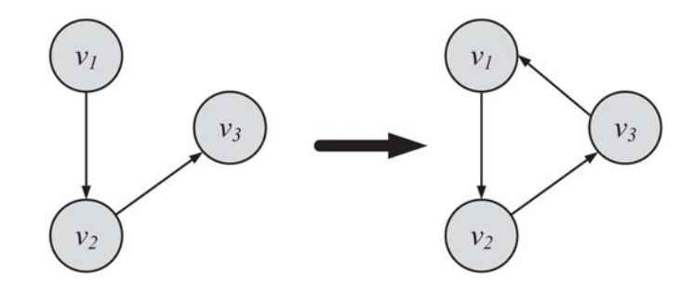
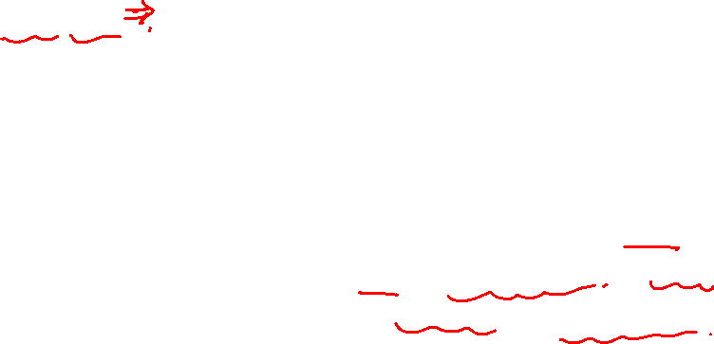
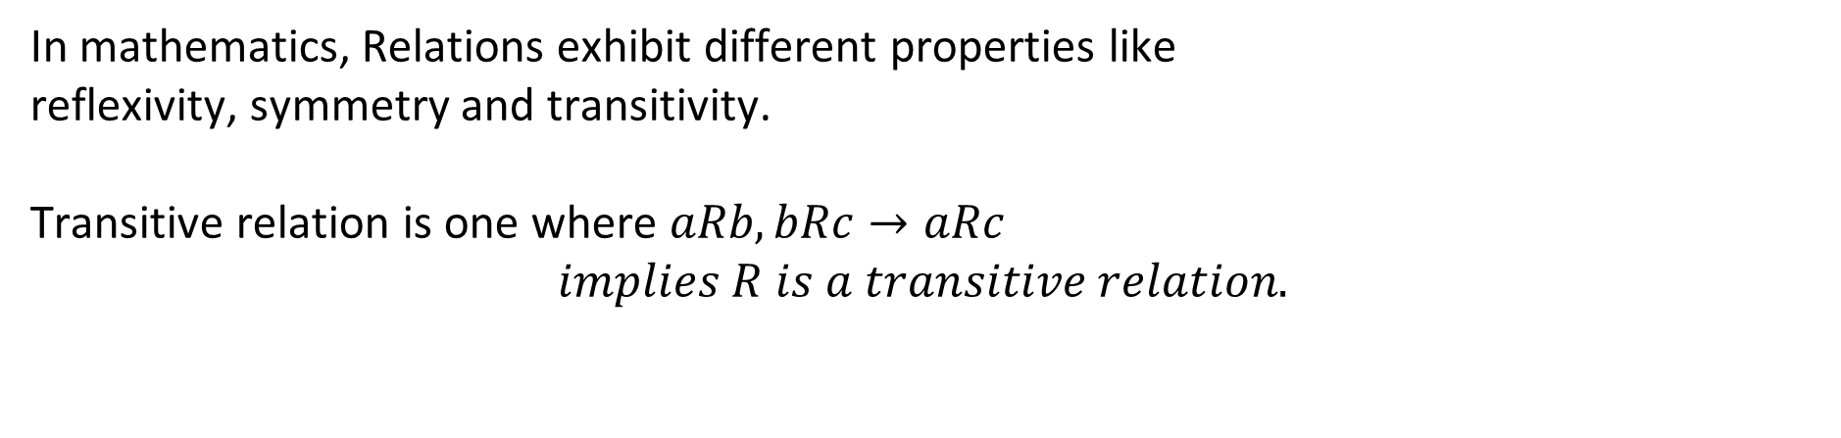
Graph Theory and its Applications
Transitivity
In mathematics, Relations exhibit different properties like
reflexivity, symmetry and transitivity.
Transitive relation is one where $aRb, bRc→aRc$
$$implies R is a transitive relation.$$
Linking Behavior: Let v1, v2, v3 denote three nodes. When edges (v1, v2) and (v2, v3) are formed, if (v3, v1) is also formed, then it is a transitive linking behavior (transitivity)
Transitivity is when a friend of my friend is my friend.

Slide 5
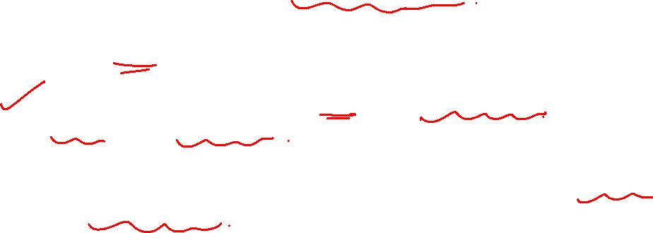
Graph Theory and its Applications
Transitive linking behavior
A transitive behavior needs at least three edges.
These three edges, along with the participating nodes, create a triangle.
Higher transitivity in a graph results in a denser graph, which in turn is closer to a complete graph.
Thus, we can determine how close graphs are to the complete graph by measuring transitivity.

Slide 6
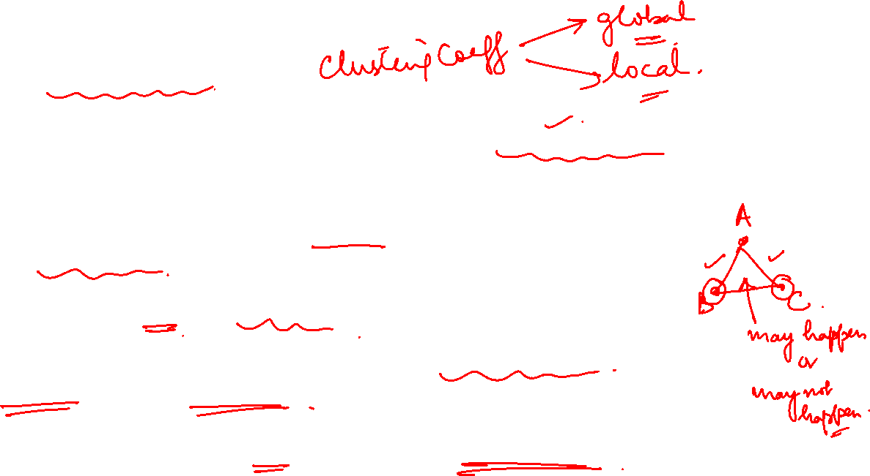
Graph Theory and its Applications
Transitive linking behavior
This can be performed by measuring the [global] clustering coefficient and local clustering coefficient.
The former is computed for the network, whereas the latter is computed for a node.
Strong Ties are often transitive than weak ties.
Transitivity is therefore an evidence for the existence of Strong ties( but not necessary and sufficient condition).
Transitivity and homophily together leads to the formation of cliques( fully connected clusters).

Slide 7
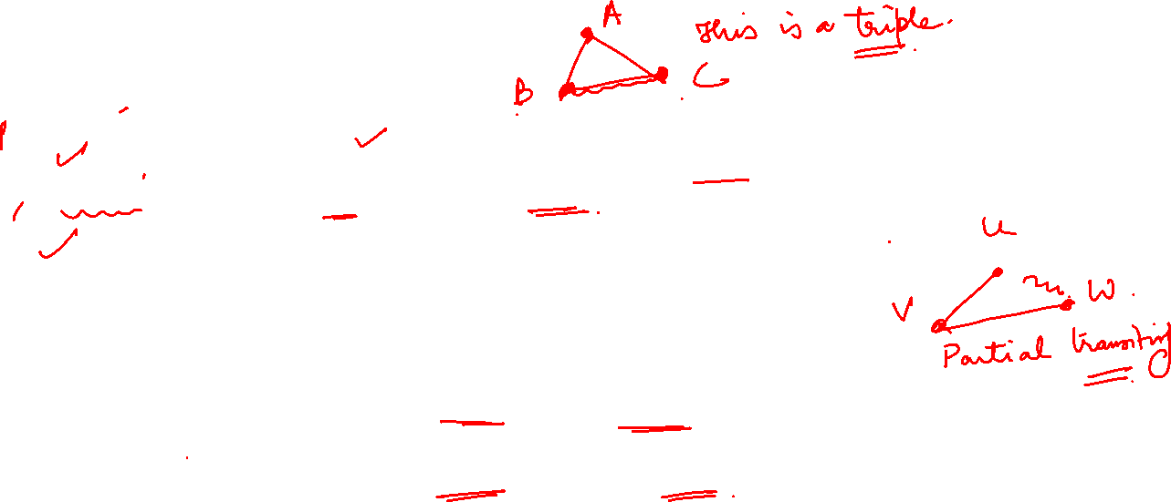
Graph Theory and its Applications
Partial transitivity
Perfect transitivity only occurs in networks where each component triple is a fully connected subgraph or clique.
Perfect transitivity is seen in a clique ( which is rare)
Partial transitivity can be useful
In general, the fact that u knows v and v knows w, does not mean that u must know w----Partial Transitivity.
However, it increases the probability that u knows w

Slide 8
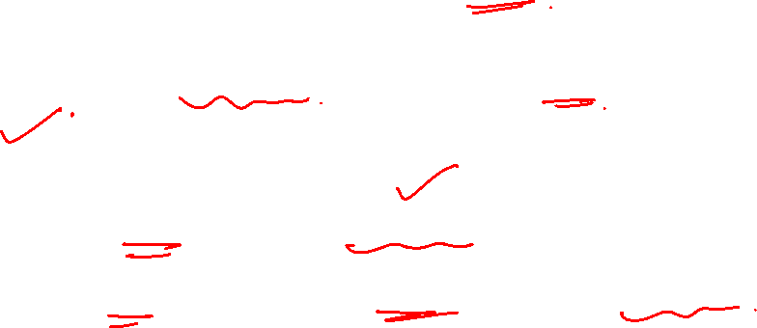
Graph Theory and its Applications
Clustering coefficient – measuring cohesivity in network
How to measure transitivity in an undirected graph ?

Slide 9
Graph Theory and its Applications
Clustering coefficient in real world networks
In real-world social networks,
friendships are highly transitive. In other words, friends of an individual are often friends with one another.
Friendship-triads/transitive-friendships result in high average
[local]clustering coefficients.
In May 2011, Facebook had an average clustering coefficient of 0.5
for individuals who had two friends; their degree was 2 .
This indicates that for 50% of all users with two friends, their two friends were also friends with each other.

Slide 10
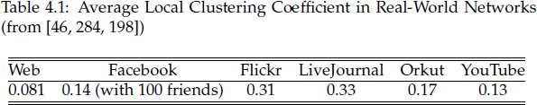
Graph Theory and its Applications
Clustering coefficient in real world networks
Table 4.1 provides the average clustering coefficient for several
real-world social networks and the web.

Slide 11
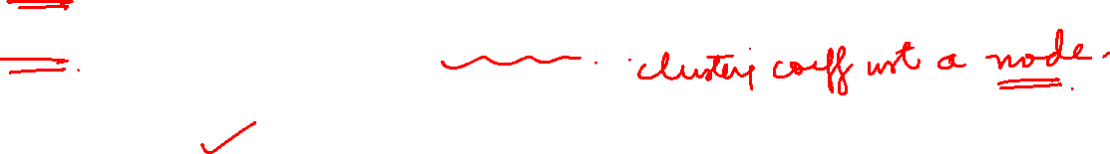
Graph Theory and its Applications
Clustering Coefficient
Two versions of this measure exist:
The global clustering coefficient(the overall clustering coefficient)
The local clustering coefficient(the individual clustering coefficient)
Two approaches exist :
Watts and Strogatz
Newman, Strogatz and Watts

Slide 12
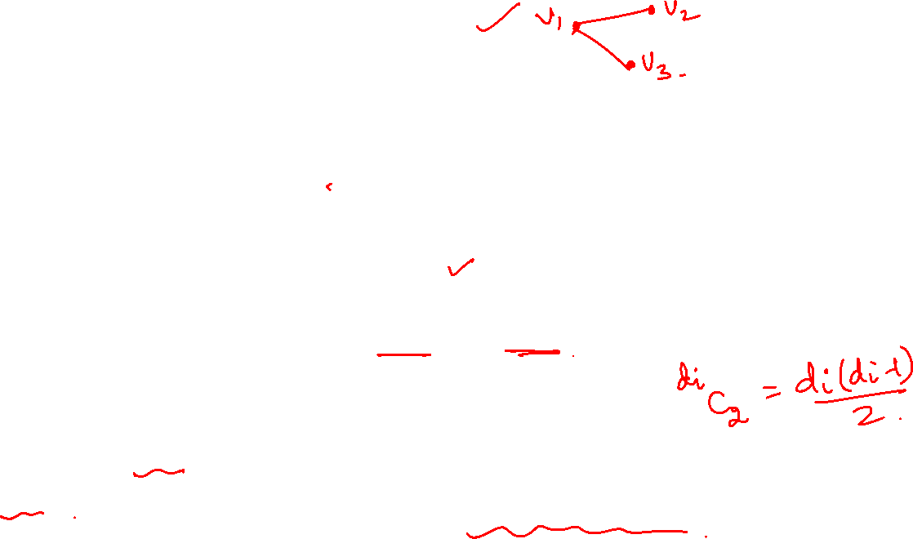
Graph Theory and its Applications
Local Clustering coefficient (Watts and Strogatz)
Local clustering coefficient measures transitivity at the node level
Commonly employed for undirected graphs
It computes how strongly neighbors of a node v (nodes adjacent to v) are themselves connected
In an undirected graph, the denominator can be rewritten as:
Since there are d_{i} neighbors of nodes v_{i}

Slide 13
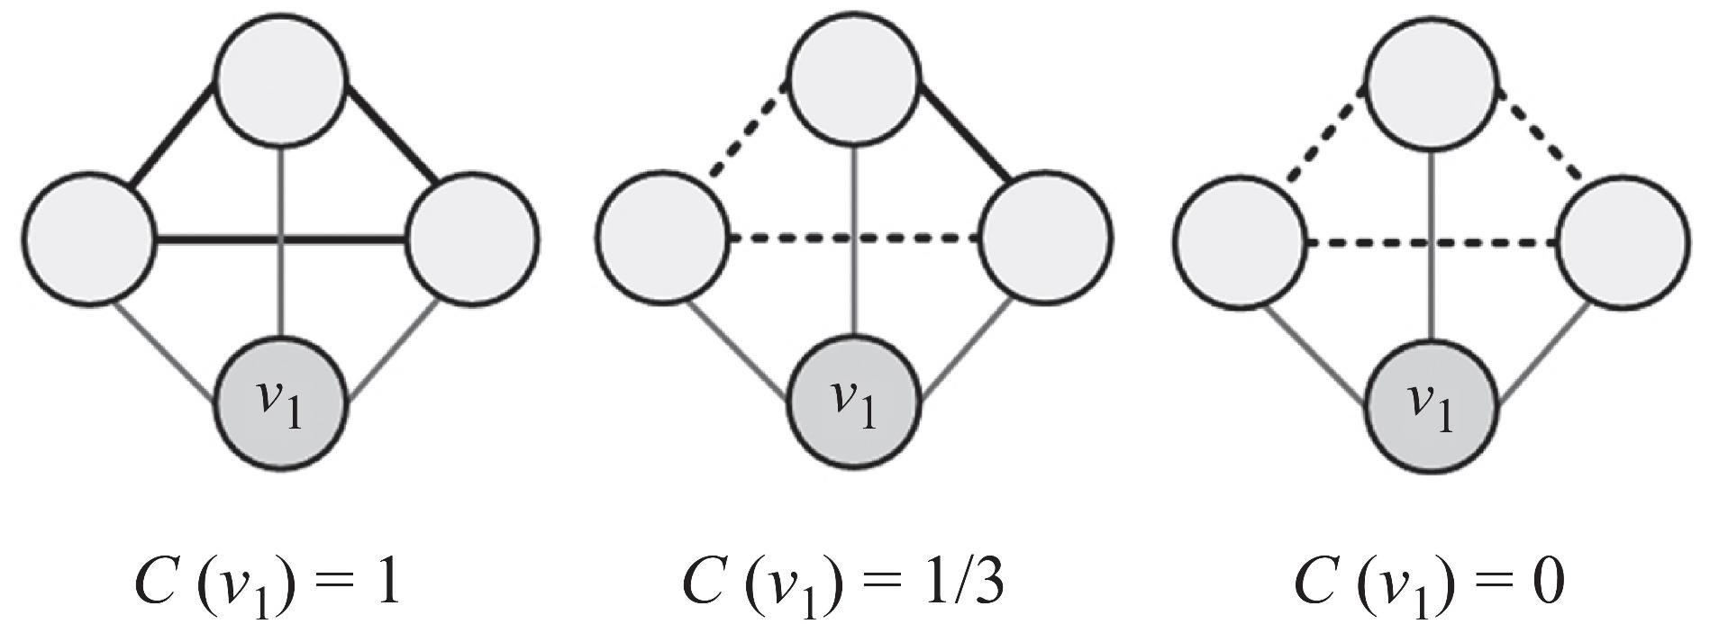
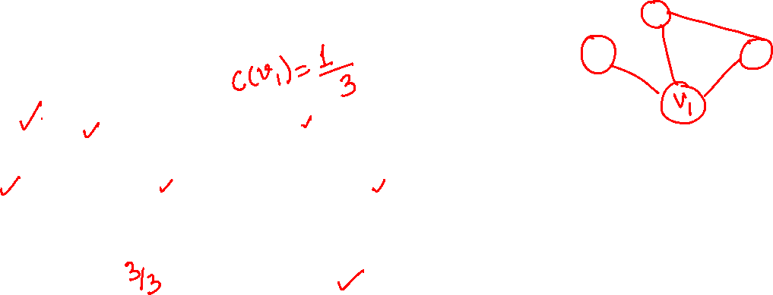

Graph Theory and its Applications
Example
Thin lines depict v_{i}’s connections to neighbors
Dashed lines are the missing/possible connections among neighbors
Solid bold lines indicate current connections amongst neighbors (connected among themselves)
When none of neighbors are connected C=0
When all neighbors are connected C=1

Slide 14

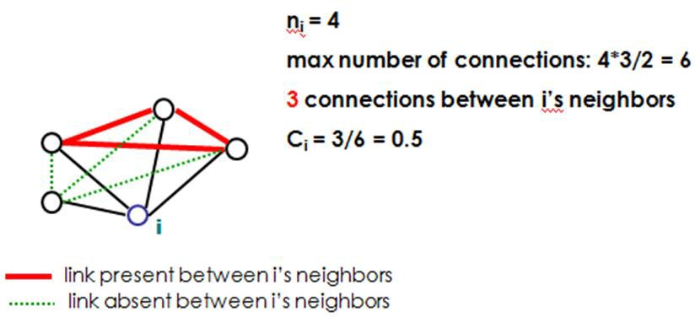
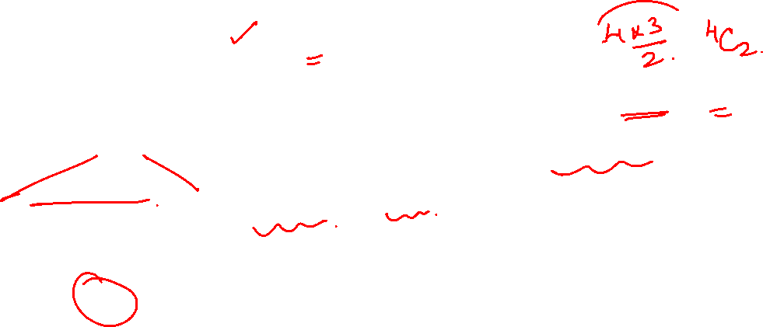
Graph Theory and its Applications
Example

Slide 15
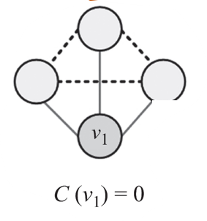
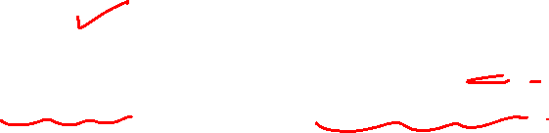
Graph Theory and its Applications
Local clustering coefficient and structural holes
Local clustering can be used as a probe for the existence of “structural holes” in a network. ( Pls recall that local clustering measures transitivity at the node level).
If two friends of node i are not connected directly and their information about one another comes via node i then i controls the flow of that information.

Slide 16
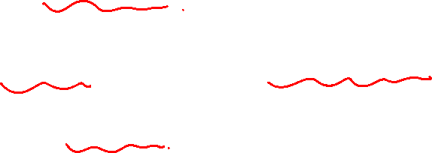
Graph Theory and its Applications
Local clustering coefficient and structural holes
The local clustering coefficient measures how influential node i is in this sense
lower values implies more structural holes around i.
Thus, local clustering can be regarded as a type of centrality measure, albeit one that takes small values for powerful individuals rather than large ones.

Slide 17
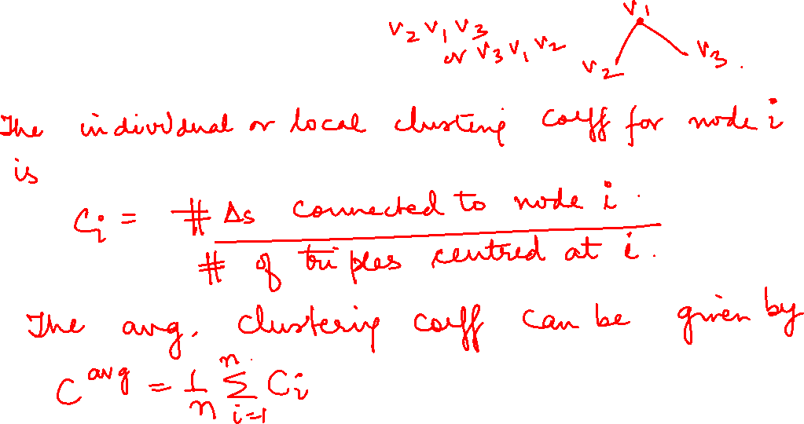
Graph Theory and its Applications
Clustering coefficient (local) in terms of triangle

Slide 18
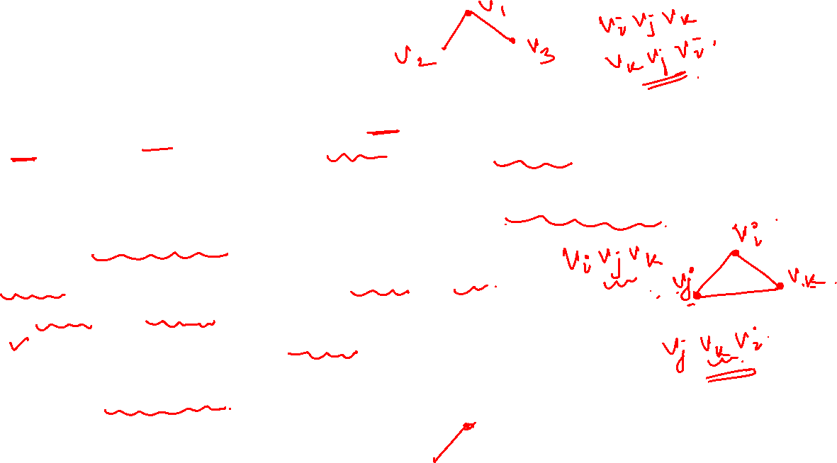
Graph Theory and its Applications
Triple in an undirected graph
A triple is an ordered set of three nodes , connected by two edges (open triple, one edge missing) or three edges (closed triple, no edge missing)
In clustering coefficient, we are interested in knowing how many open triples are becoming closed triples
v_{i}, v_{j}, v_{k} are three nodes with edges ij and jk
v_{i} v_{j} v_{k} and v_{k} v_{j} v_{i} are same triple as the edge v_{i} v_{k} or v_{k} v_{i} are missing
v_{i} v_{j} v_{k} (edges ij and jk) and v_{j} v_{k} v_{i} (edges jk and ki) are different triples as different edges v_{i} v_{k} or v_{j} v_{i} are missing
A triangle has 3 triples (they happen to be closed, you center the triple at different vertices)

Slide 19
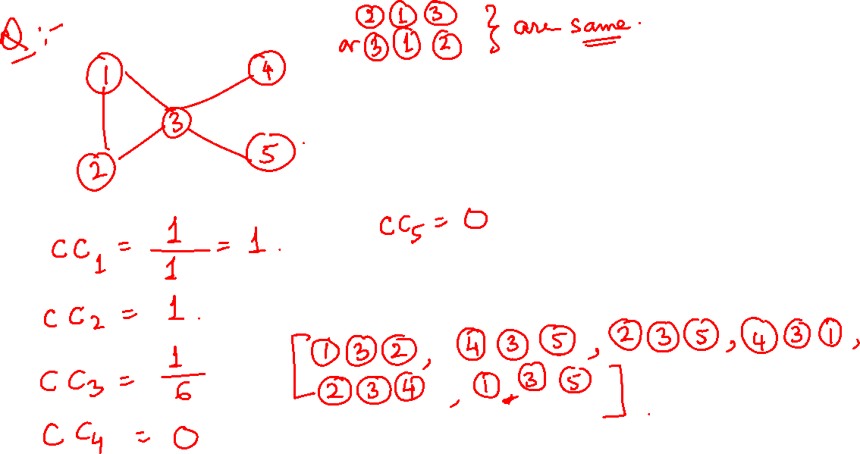

Slide 20
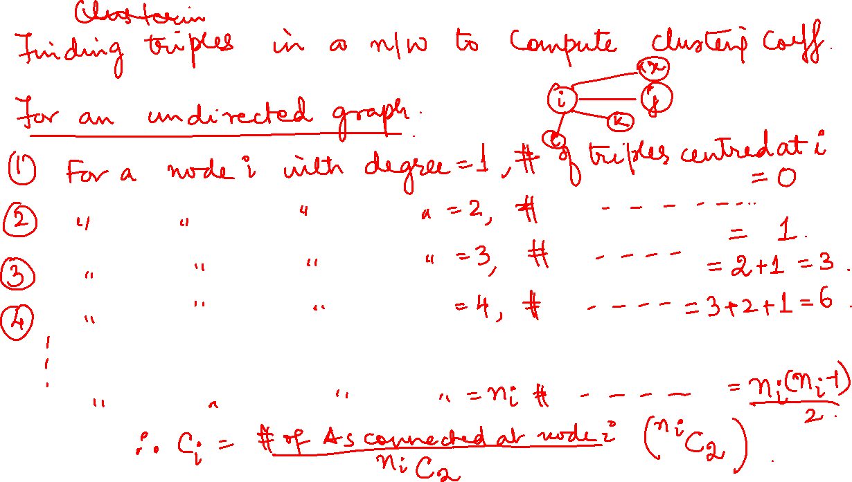

Slide 21
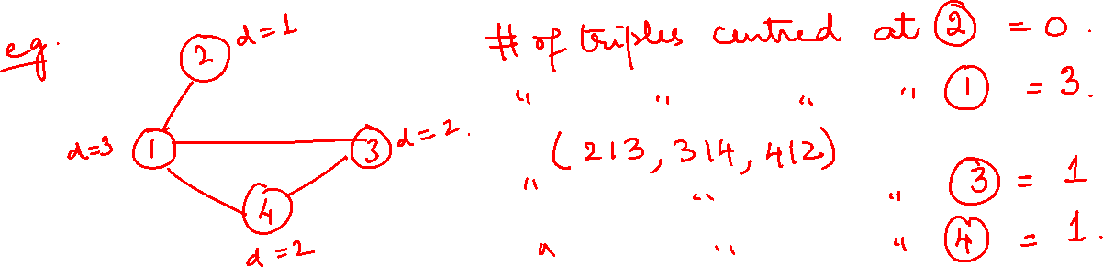

Slide 22
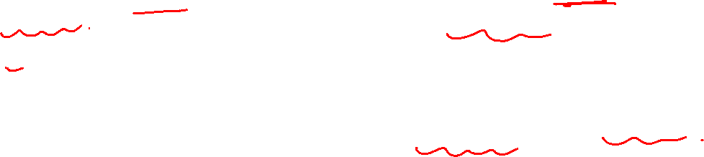
Graph Theory and its Applications
Average of local clustering coefficient ?
Local clustering coefficient is defined for a single node.
If we find the average clustering coefficient for all vertices of a network, we practically have the clustering coefficient of the network.
It gives an approximate measure of transitivity across the graph

Slide 23
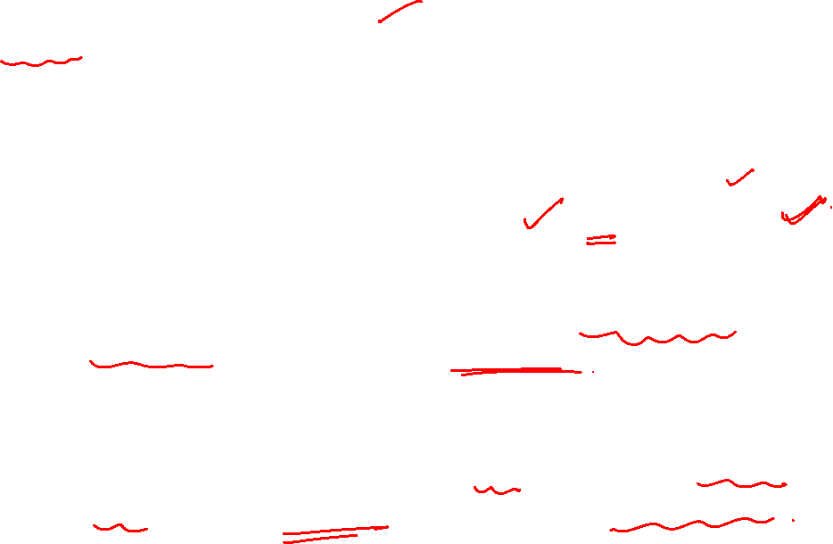
Graph Theory and its Applications
Global clustering coefficient (Watts and Strogatz)
Watts and Strogatz have suggested computing the clustering coefficient of a network as the average over all the local clustering coefficients of the vertices:
The above definition tends to give high cc values for networks dominated by vertices of low degree (regularly the case in real networks).
Probably because there are some nodes of very high degree in giant component that pushes up the average.

Slide 24
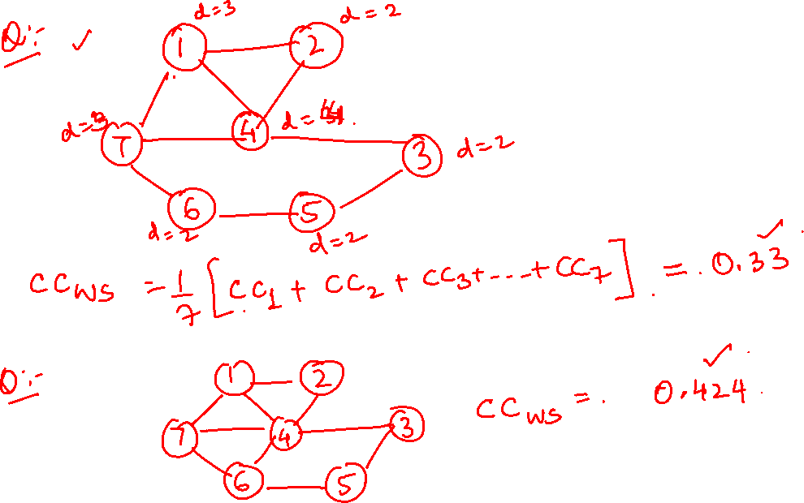

Slide 25
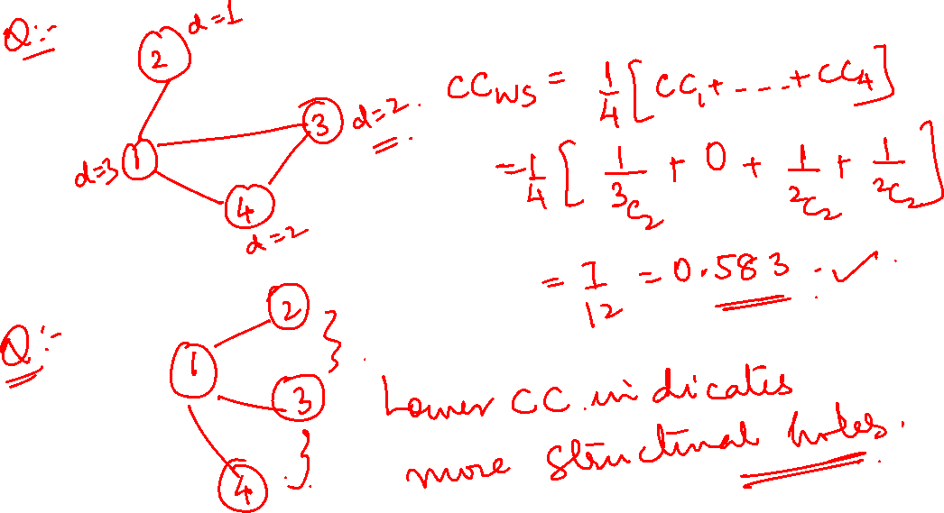

Slide 26
NETWORK ANALYSIS AND MINING
Global Clustering coefficient (Newman, Strogatz and Watts)

Slide 27
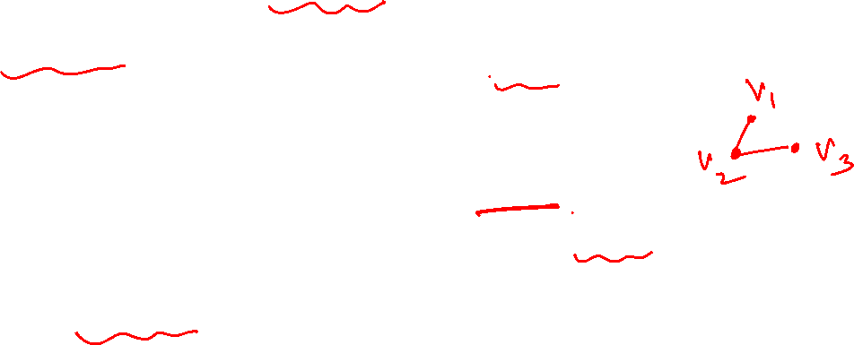
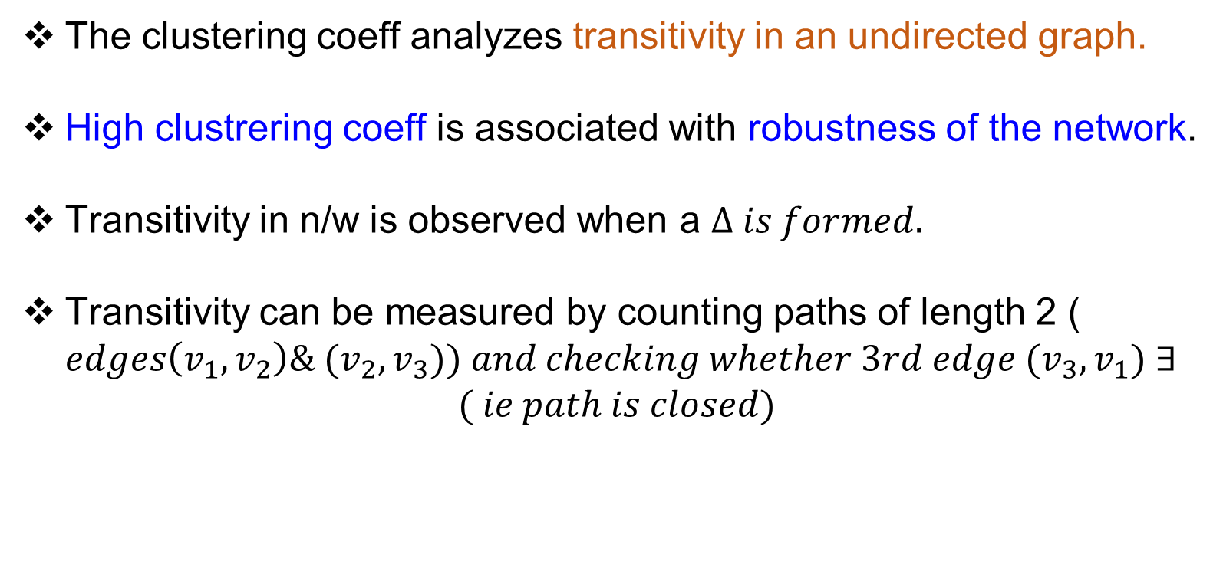
Graph Theory and its Applications
Global Clustering coefficient (Newman, Strogatz and Watts)
The clustering coeff analyzes transitivity in an undirected graph.
High clustrering coeff is associated with robustness of the network.
Transitivity in n/w is observed when a $∆ is formed.$
Transitivity can be measured by counting paths of length 2 ( $edges\left(v_{1},v_{2}\right)\& (v_{2},v_{3})) and checking whether 3rd edge (v_{3},v_{1}) ∃$
$$( ie path is closed)$$
Thus, clustering coefficient C is defined as $C=\frac{|Closed Paths of Length 2|}{|Paths of length 2|}$

Slide 28
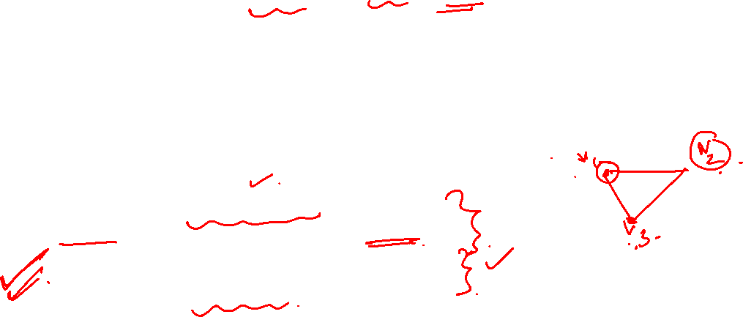
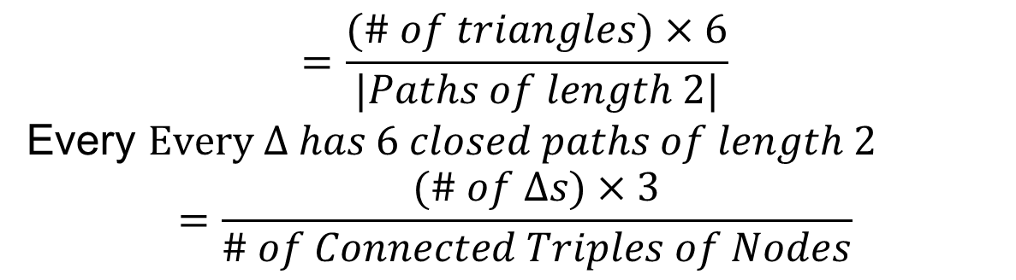
Graph Theory and its Applications
Global Clustering coefficient (Newman, Strogatz and Watts)
Thus, clustering coefficient C is defined as $C=\frac{|Closed Paths of Length 2|}{|Paths of length 2|}$
$$=\frac{(\# of triangles)×6}{|Paths of length 2|}$$
Every $Every ∆ has 6 closed paths of length 2$
$$=\frac{(\# of ∆s)×3}{\# of Connected Triples of Nodes}$$

Slide 29
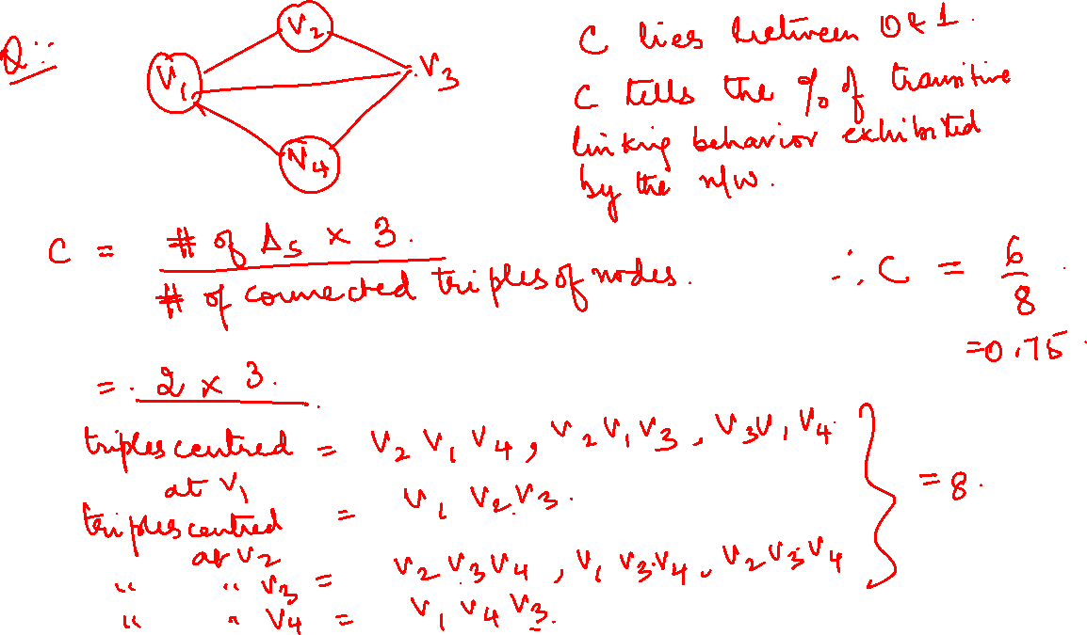

Slide 30
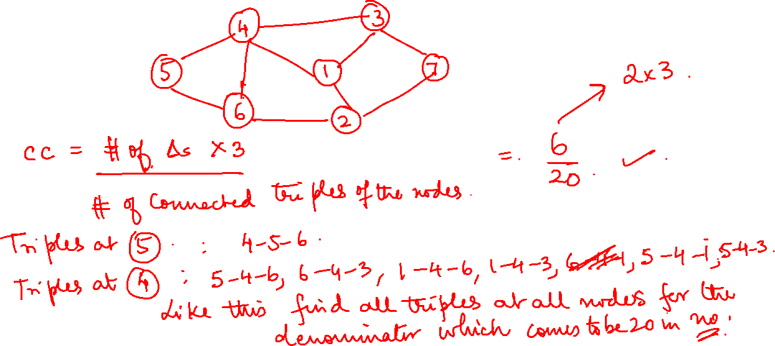
Graph Theory and its Applications
Global Clustering coefficient (Newman, Strogatz and Watts)
Example:

Slide 31
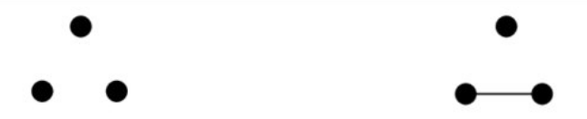
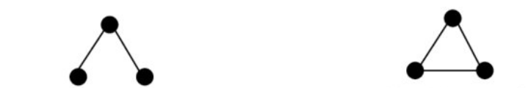
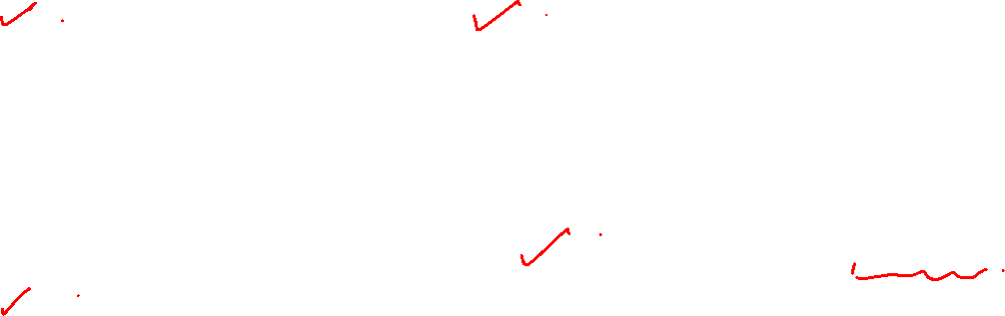
Graph Theory and its Applications
Possible triadic relationships with undirected graphs
With undirected graphs, there are 4 possible triadic relationships namely:
No Ties
One Tie
The counts of relative prevalence of all 4 types of relations across all possible Triples can give a good sense of extent to which a population is characterized by “ isolation”, “ couples only”, “ structural holes” and “ clusters”
2 Ties ( Open Triad- 2 edges with a shared vertex)
All 3 Ties ( Closed triad/balanced/transitive)

Slide 32

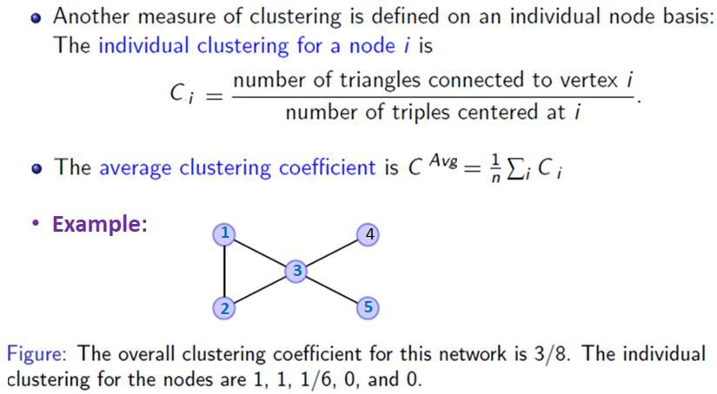
NETWORK ANALYSIS AND MINING
Clustering coefficient (local) in terms of triangle
The clustering coefficient of a node i is
the fraction of pairs of i’s friends that are connected to each other by edges, or
What portion of i’s neighbors are connected?

Slide 33
Graph Theory and its Applications
Clustering coefficient in terms of triangle (how many triples are)
Finding triples (simple approach) in a network to compute Clustering Coefficient.
In an undirected graph,
For a node i having degree=1 , number of triples centered at node i = 0
For a node i having degree=2 , number of triples centered at node i = 1
For a node i having degree=3 , number of triples centered at node i =2+1=3
For a node i having degree=4 , number of triples centered at node i =3+2+1=6
In general, for a node i having degree=n_{i}, number of triples centered at node i
= [n_{i}*(n_{i}-1)]/2
C =
Number of triangles connected to node i
=
Number of triangles connected to node i
i i
i i
i
i i
Number of triples centered at node i
[n *(n -1)]/2
Where n_{i} is node i degree/connections

Slide 34
Graph Theory and its Applications
Clustering coefficient in terms of triangle (how many triples are)
Deg of node 1=3
Deg of node 2=1
Deg of Node 3=2
Deg of Node 4=2
Thus, # of triples centered at node 2= 0
# of triples centered at node 3= 1
# of triples centered at node 4= 1
# of triples centered at node 1= 3 (213,314,412)
( Pls note that 314 and 413 are same)
2
1
3
4

Slide 35
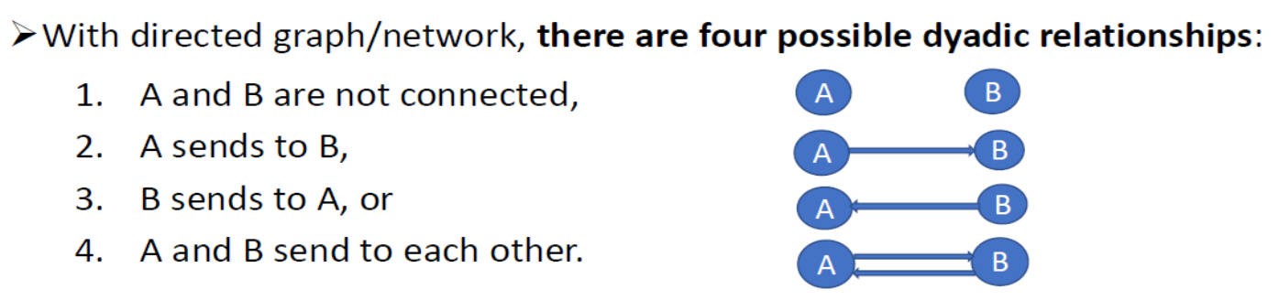
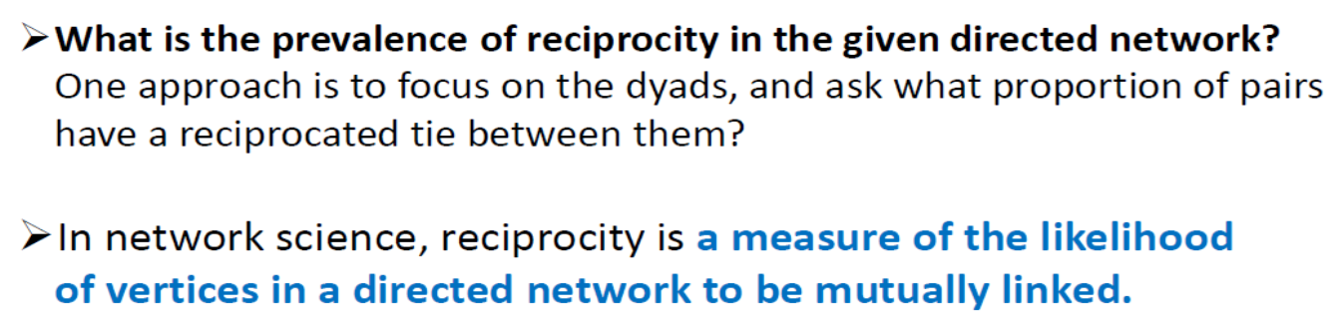
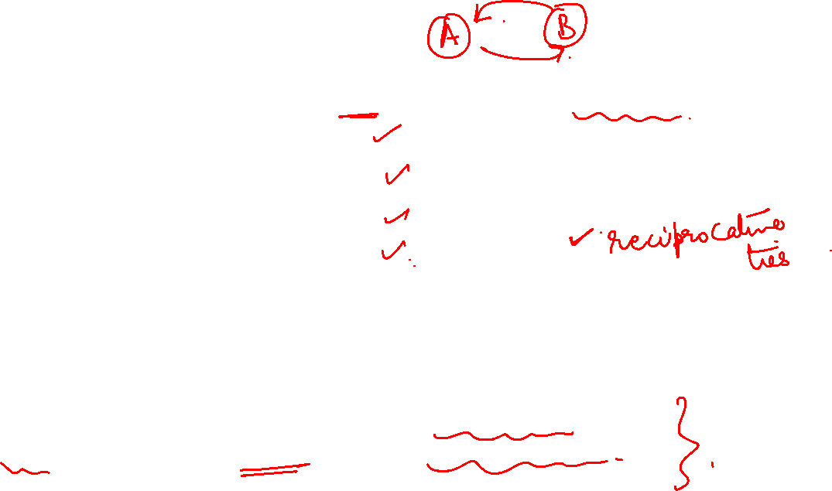
Graph Theory and its Applications
Reciprocity is a dyadic relationship

Slide 36
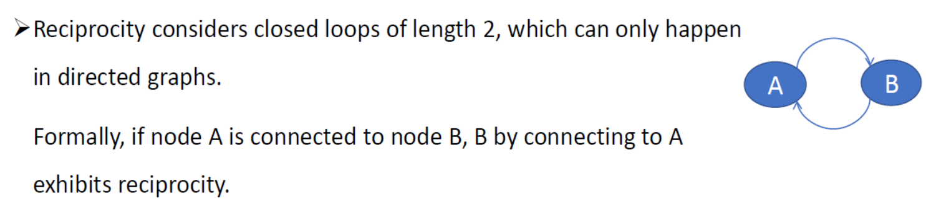
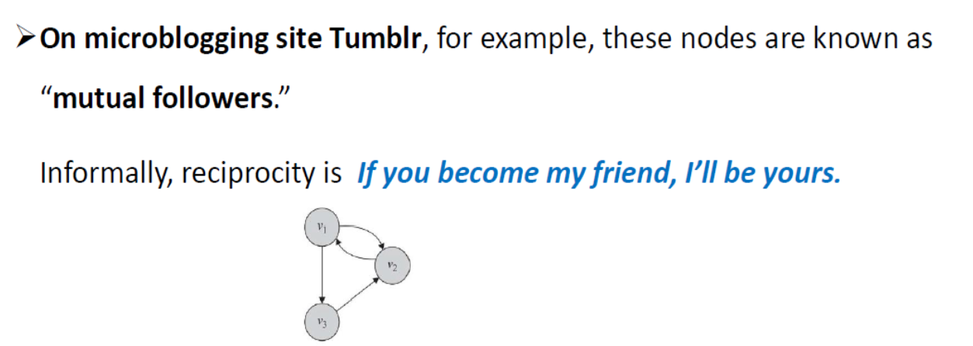
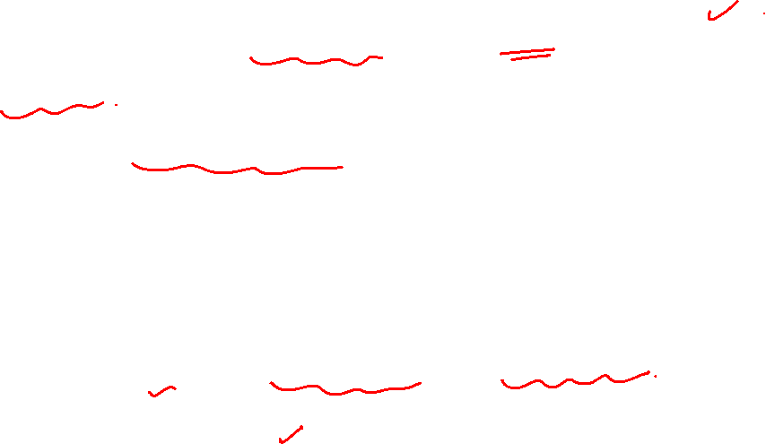
Graph Theory and its Applications
Reciprocity

Slide 37
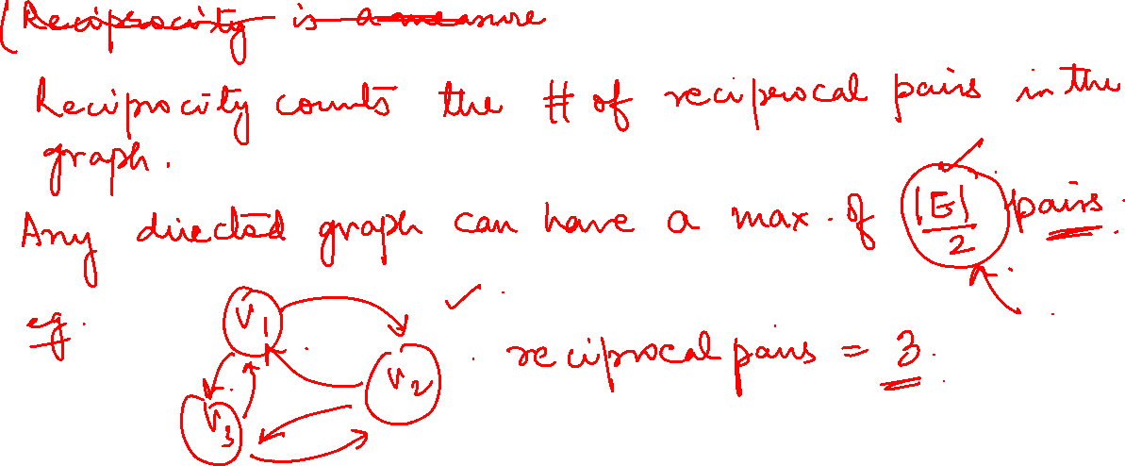
Graph Theory and its Applications
Calculating reciprocity

Slide 38
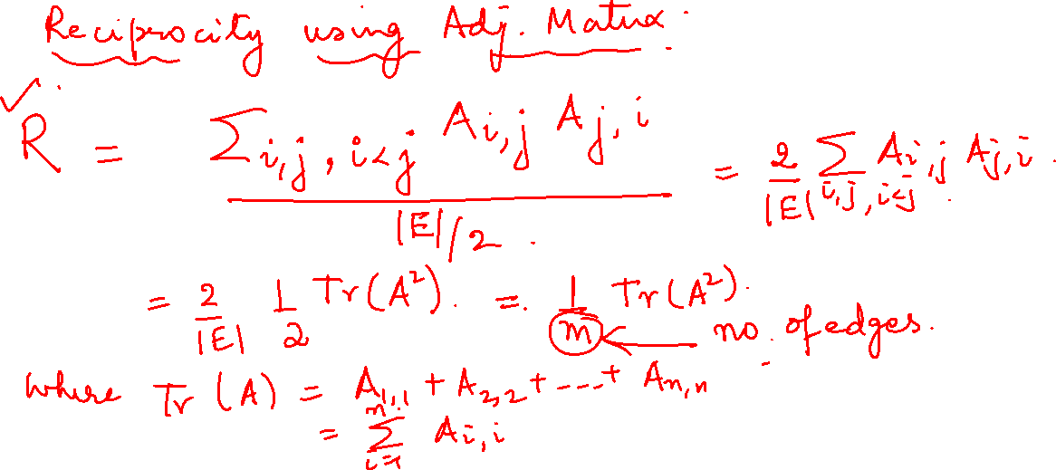
Graph Theory and its Applications
Calculating reciprocity

Slide 39
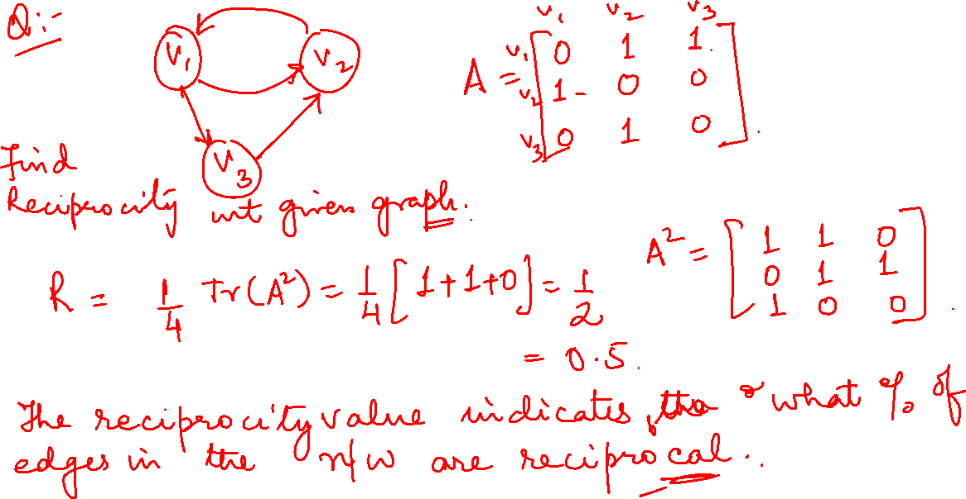

Slide 40
Graph Theory and its Applications
Using signs in a Triad – Social Balance (transitivity with signed edges) Theory
Social balance theory discusses consistency in friend/foe relationships among individuals.
Informally, social balance theory says friend/foe relationships are consistent when
In the signed network
Positive edges demonstrate friendships (w_{ij}=1)
Negative edges demonstrate being enemies (w_{ij}=-1)
Social balance theory measures the consistency of attitudes that individual have towards one another

Slide 41
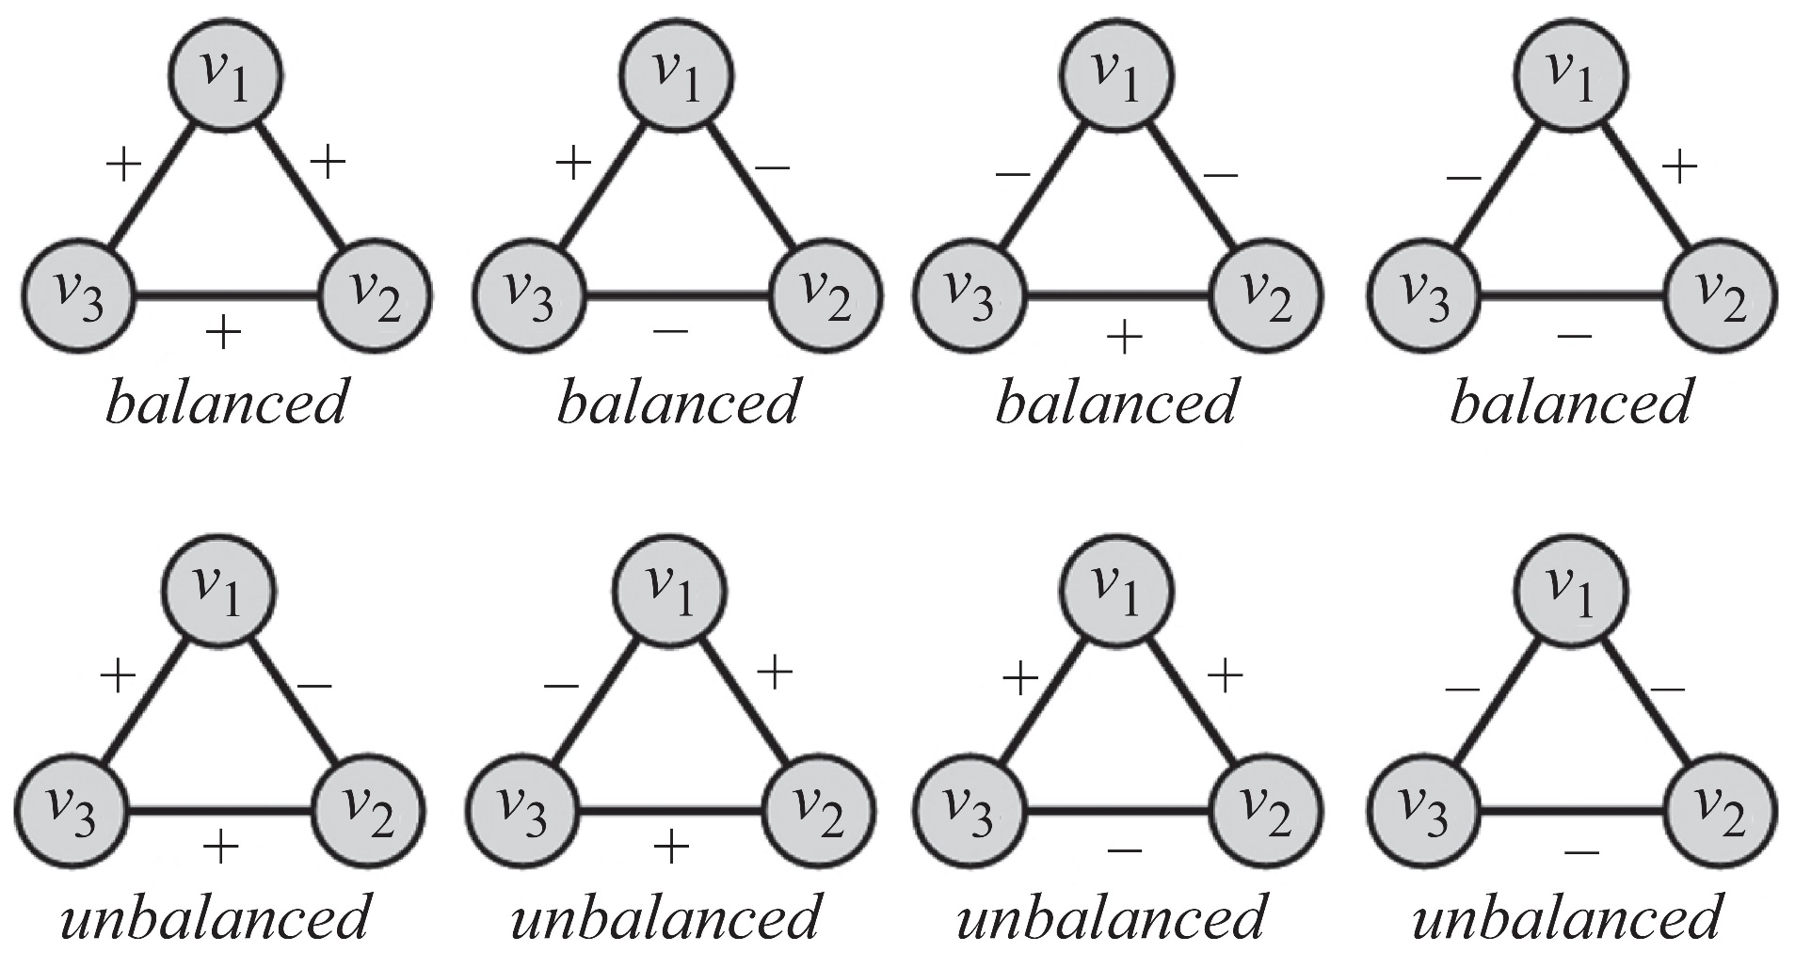
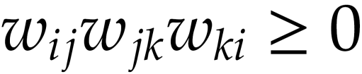
Graph Theory and its Applications
Social Balance Theory( or Structural Balance Theory)
Triangle of nodes i, j, and k, is balanced, if and only if
w_{ij} denotes the value of the edge between nodes i and j
For any cycle if the multiplication of edge values become positive, then the cycle is socially balanced.
Triangles with 1 or 3 ‘+’s are balanced (similarly even no of ‘-’ signs are also balanced).
Triangles with 0 or 2 ‘+’ are unbalanced.

Slide 42
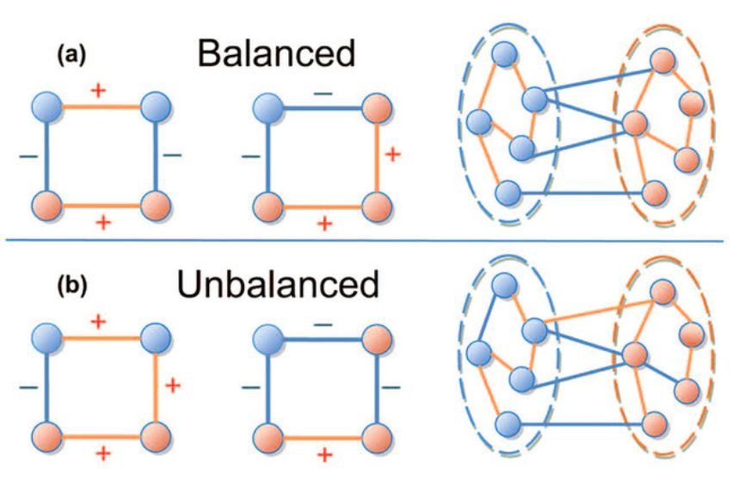
Graph Theory and its Applications
Social Balance Theory( or Structural Balance Theory)
Networks containing only loops with even number of minus signs are said to show structural balance.
This is also true for loops of length greater than three.

Slide 43
Graph Theory and its Applications
Social Balance Theory( or Structural Balance Theory)
A balanced network can be divided into connected groups of vertices such that all connections between members of the same group are positive and all connections between members of different groups are negative.

Slide 44
Graph Theory and its Applications
Structural Balance Theory
A network that can be divided into groups as per the above theorem are clusterable. Hence, a balanced network is clusterable as well.
Structural balance theory predicts that certain configurations of positive and negative relationships in a triad are inherently less stable (unbalanced) and should be eliminated.

Slide 45
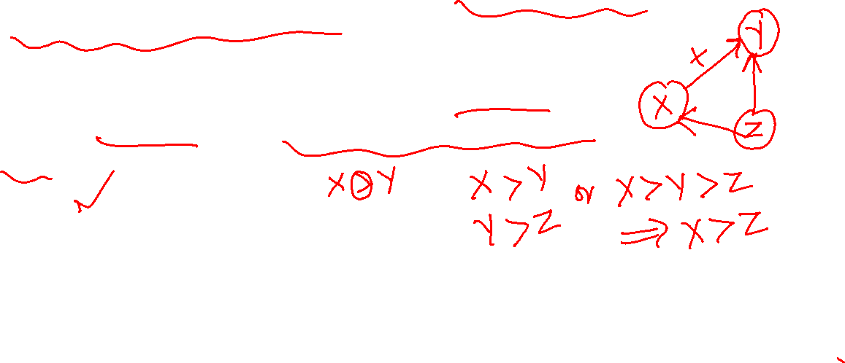
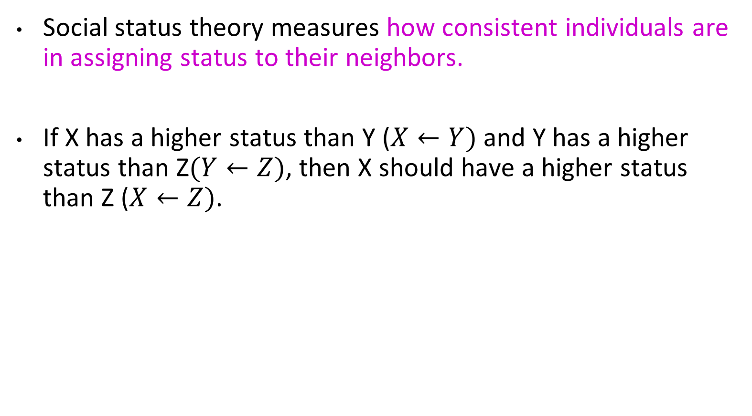
Graph Theory and its Applications
Social Status Theory
Social status theory measures how consistent individuals are in assigning status to their neighbors.
If X has a higher status than Y ($X←Y)$ and Y has a higher status than Z$(Y←Z)$, then X should have a higher status than Z ($X←Z)$.
X
Y
Z

Slide 46


Graph Theory and its Applications
Social Status Theory
unbalanced configuration
balanced configuration
A directed + edge from node v1 to node v2 shows that v2 has a higher status than v1, and a negative one shows that v3 has lower status than v1.
Sample Graphs for Social Status Theory.
‘+’ and ‘-’ signs show higher or lower status depending on the arrow direction
In a cycle of n nodes, where n − 1 consecutive edges are positive and the last edge is negative, social status theory considers the cycle balanced

Slide 47
Graph Theory and its Applications
Social Status Theory
unbalanced configuration
balanced configuration
A directed + edge from node v1 to node v2 shows that v2 has a higher status than v1, and a negative one shows that v3 has lower status than v1.
Sample Graphs for Social Status Theory.
‘+’ and ‘-’ signs show higher or lower status depending on the arrow direction
Note: the identical configuration can be considered balanced by social balance theory and unbalanced based on social status theory

Slide 48
THANK YOU
Dr. Arti Arya
Department of Computer Science and Engineering
artiarya@pes.edu

